Slide 1
Session 14
String Class and Methods
Session Outcome
At the end of this session students will be able to understand Strings and use the methods in String class

Slide 2
Session Content
String Class
Difference between String and StringBuffer
Methods of creating Strings
Difference in memory for Strings
String Handling Methods
String method based Program
Sorting of names using Java Program

Slide 3
String Class
String is a group of characters. They are objects of type String.
Once a String object is created it cannot be changed.
Strings are Immutable.
To get changeable strings use the class called StringBuffer.
String and StringBuffer classes are declared as final, so there cannot be subclasses of these classes.
The default constructor creates an empty string.
String s = new String( );

Slide 4
Difference between String and StringBuffer
StringBuffer class is mutable. A character is easily inserted into StringBuffer.
String is slow and consumes more memory when you concat too many strings because every time it creates new instance.
StringBuffer is fast and consumes less memory when you concat strings.
String class overrides the equals( ) method of Object class. So you can compare the contents of two strings by equals() method.
StringBuffer class doesn't override the equals() method of Object class.

Slide 5
Methods to Create String
Method 1:
To Create a String in JAVA is
String str = "abc";
Method 2:
char data[] = {'a', 'b', 'c'};
String str = new String(data);
If data array in the above example is modified after the string object str is created, then str remains unchanged.

Slide 6
Methods to Create String
Method 3:
Construct a string object by passing another string object.
String str2 = new String(str);

Slide 7
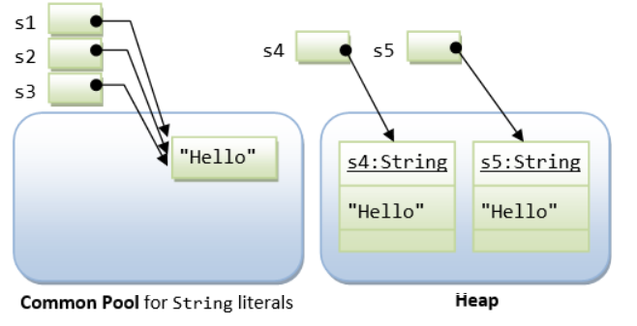
Difference in memory for String
String s1 = "Hello"; // String literal
String s2 = "Hello"; // String literal
String s3 = s1; // same reference
String s4 = new String("Hello"); // String object
String s5 = new String("Hello"); // String object

Slide 8
String Concatenation
+ operator
The + operator is used to concatenate two or more strings.
String myName = "Varun";
String s = "My name is" + myName+ ".";
Java compiler converts an operand to a String whenever the other operand of the + is a String object.
String myAge = “My age is";
String s = myAge + 24;

Slide 9
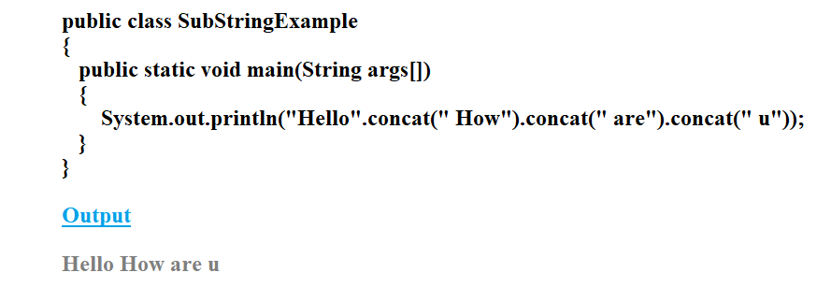
String Concatenation
Concat( ) method
This method concatenates one string to the end of another string.
public String concat(String anostr);

Slide 10
String Length and Character At
length( )
The length( ) method returns the length of the string.
System.out.println("Varun".length( ));
output: 5
charAt( )
Method returns the character at the specified index. An index ranges from 0 to length() - 1.
char c;
c = "abc".charAt(1);
// c = “b”

Slide 11
String Equals Method
equals( )
The equals( ) method returns true if the invoking object character sequence is same as argument object.
Provided both the objects are not null.
Otherwise, returns false.
public boolean equals(Object anObject);
String myStr1 = "Hello";
String myStr2 = "Hello";
String myStr3 = "Another String";

Slide 12
String Equals Method
equals( )
System.out.println(myStr1.equals(myStr2));
Output: true
System.out.println(myStr1.equals(myStr3));
Output: false

Slide 13
String Equals Method
equalsIgnoreCase( )
The equalsIgnoreCase ( ) method returns true if the invoking object character sequence is same as argument object.
Provided both the objects are not null.
Otherwise, returns false.
public boolean equalsIgnoreCase(Object anObject);
String myStr1 = “hello";
String myStr2 = "Hello";
String myStr3 = "Another String";

Slide 14
String Equals Method
equalsIgnoreCase( )
System.out.println(myStr1.equalsIgnoreCase(myStr2));
Output: true
System.out.println(myStr1.equalsIgnoreCase(myStr3));
Output: false

Slide 15
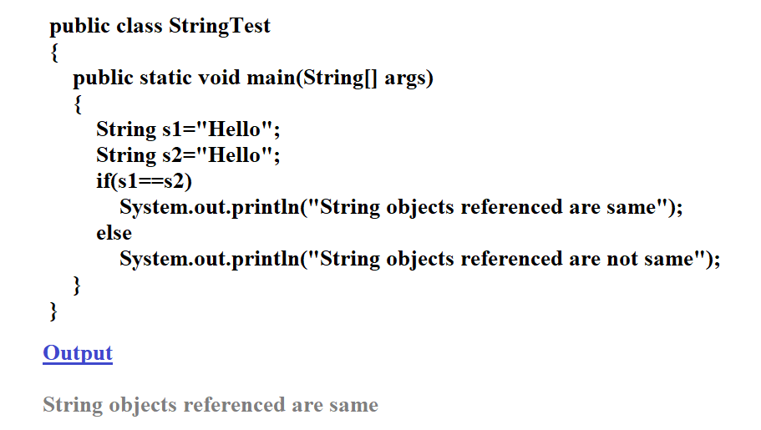
Comparing Strings using == operator

Slide 16
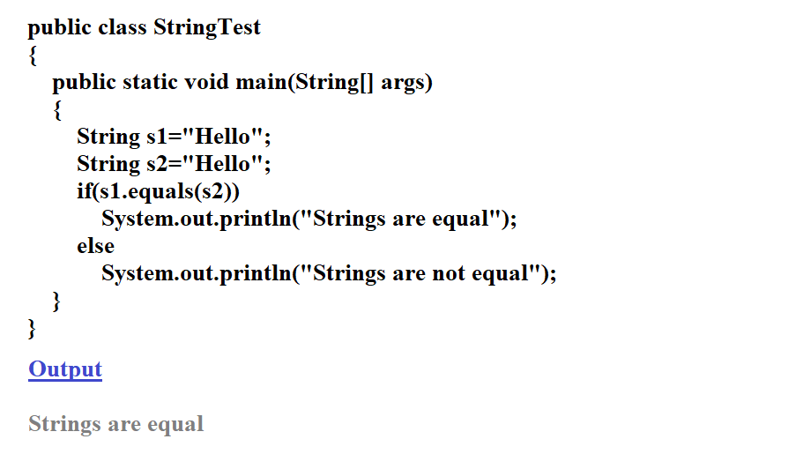
Comparing Strings using equals method

Slide 17
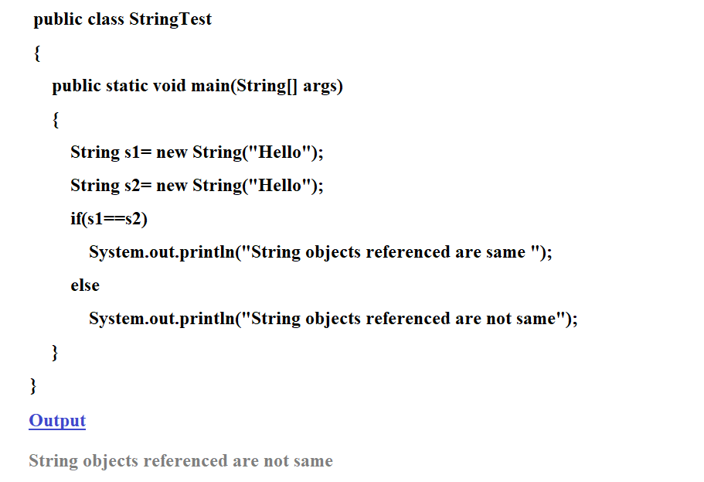
Comparing Strings using == operator

Slide 18
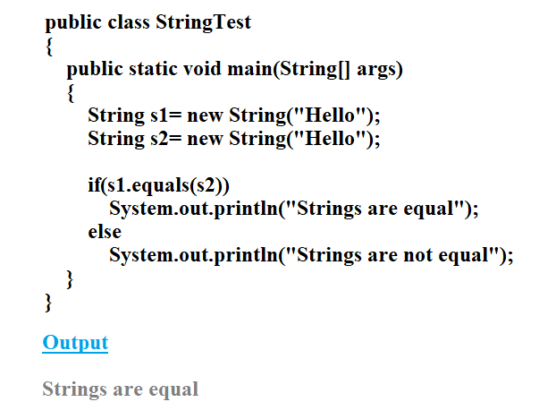
Comparing Strings using equals method

Slide 19
Prefix and Suffix Method
startsWith( )
Tests if this string starts with the specified prefix.
public boolean startsWith(String prefix)
System.out.println("January".startsWith("Jan"));
Output : true
endsWith( )
Tests if this string ends with the specified suffix.
public boolean endsWith(String prefix)
System.out.println("January".endsWith(“ry"));
Output : true

Slide 20
Comparing Strings
compareTo( )
Compares two strings and to know which string is bigger or smaller.
– We will get a negative integer, if this String object is less than the argument string.
– We will get a positive integer if this String object is greater than the argument string.
– We will get a return value 0 (zero), if these strings are equal.
public int compareTo(String anotherString)
public int compareToIgnoreCase(String str)

Slide 21
Indexof Method
indexOf( )
Searches for the first occurrence of a character or substring. Returns -1 if the character does not occur.
Method 1
public int indexOf(int ch)
It searches for the character represented by ch within this string and returns the index of first occurrence of this character.

Slide 22
Indexof Method
Method 2
public int indexOf(String str)
It searches for the substring specified by str within this string and returns the index of first occurrence of this substring.
Method 3
public int indexOf(int ch, int fromIndex)
It searches for the character represented by ch within this string and returns the index of first occurrence of this character starting from the position specified by fromIndex.

Slide 23
Indexof Method
Method 4
public int indexOf(String str, int fromIndex)
Returns the index within this string of the first occurrence of the specified substring, starting at the specified index.

Slide 24
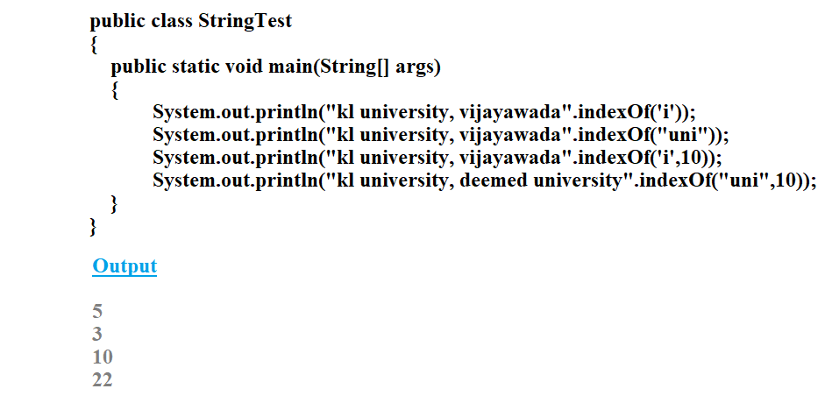
Indexof Method Example

Slide 25
lastIndexof Method
lastIndexOf( )
This method returns the position of the last occurrence of specified character(s) in a string.
public int lastIndexOf(String str)
public int lastIndexOf(String str, int fromIndex)
public int lastIndexOf(int char)
public int lastIndexOf(int char, int fromIndex)
fromIndex - An int value, representing the index position to start the search from. If omitted, the default value is the length of the string.

Slide 26
substring Method
substring( )
This method returns a new string that is a substring of the string.
Method-1
public String substring(int begIndex)
The substring begins with the character at the specified index and extends to the end of this string.
Method-2
public String substring(int begIndex, int endIndex)
The substring begins with the character at the specified index and extends to the end of this string or up to endIndex – 1, if the second argument is given.

Slide 27
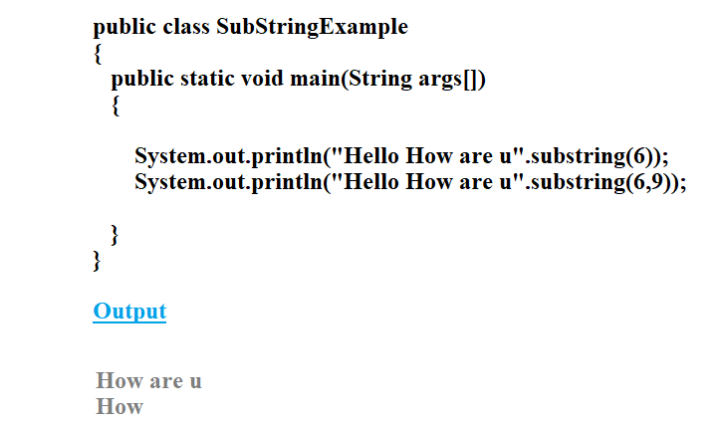
substring Method

Slide 28
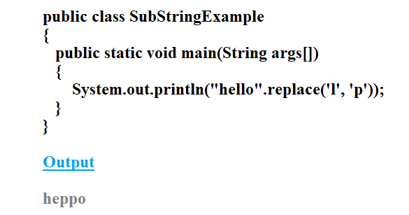
replace Method
replace( )
This method searches a string for a specified character, and returns a new string with the replaced character.
public String replace(char searchChar, char newChar)

Slide 29
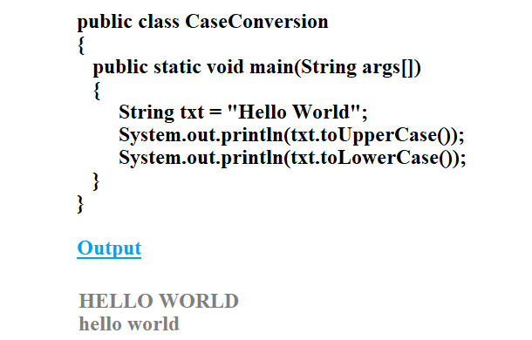
String Case Conversion Method
toLowerCase( )
Method converts all of the characters in a String to lower case.
toUpperCase( )
Method converts all of the characters in a String to upper case.

Slide 30
String Conversion Method
valueOf( )
This method returns the string representation of the passed argument.
public static String valueOf(boolean b)
public static String valueOf(char c)
public static String valueOf(char[] data)
public static String valueOf(double d)
public static String valueOf(float f)
public static String valueOf(int i)

Slide 31
String Conversion Method
valueOf( )
public static String valueOf(long l)
public static String valueOf(Object obj)
public static String valueOf(char[] data, int offset, int
count)

Slide 32
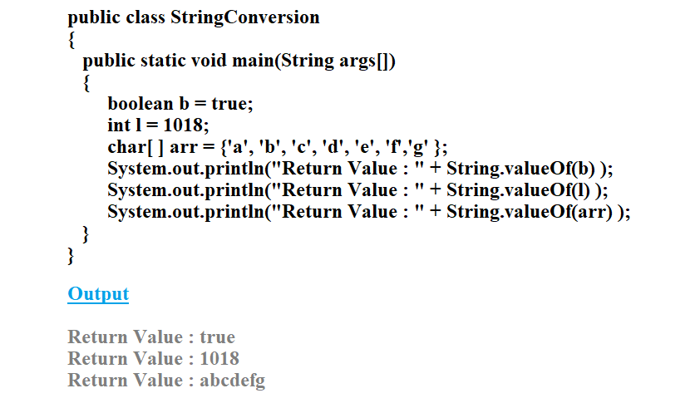
String Conversion Method

Slide 33
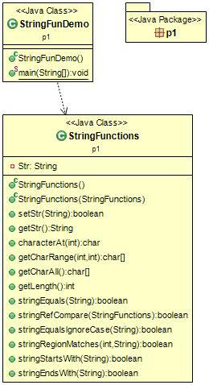
Program-1
Write a program to implement the following.
charAt( )
getChars( )
toCharArray( )
length( )
equals( )
== operator
equalsIgnoreCase( )
regionMatches( )
startsWith( )
endsWith( )

Slide 34
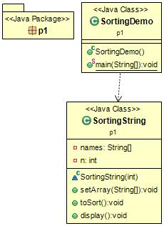
Program-2
Write a program to read names from the keyboard and sort the names in ascending order using compareTo( ).

Slide 35
Different Constructors
1. String(byte[] byte_arr)
Construct a new String by decoding the byte array. It uses the platform’s default character set for decoding.
byte[] b_arr = {71, 101, 101, 107, 115}; String s_byte =new String(b_arr); //Geeks
2. String(byte[] byte_arr, Charset char_set)
Construct a new String by decoding the byte array. It uses the char_set for decoding.
byte[] b_arr = {71, 101, 101, 107, 115}; Charset cs = Charset.defaultCharset(); String s_byte_char = new String(b_arr, cs); //Geeks
3. String(byte[] byte_arr, String char_set_name)
Construct a new String by decoding the byte array. It uses the char_set_name for decoding. It looks similar to the above constructs and they appear before similar functions but it takes the String(which contains char_set_name) as parameter while the above constructor takes CharSet.
byte[] b_arr = {71, 101, 101, 107, 115}; String s = new String(b_arr, "US-ASCII"); //Geeks

Slide 36
Different Constructors
4. String(byte[] byte_arr, int start_index, int length)
Construct a new string from the bytes array depending on the start_index(Starting location) and length(number of characters from starting location).
byte[] b_arr = {71, 101, 101, 107, 115}; String s = new String(b_arr, 1, 3); // eek
5. String(byte[] byte_arr, int start_index, int length, Charset char_set)
Construct a new string from the bytes array depending on the start_index(Starting location) and length(number of characters from starting location).Uses char_set for decoding.
byte[] b_arr = {71, 101, 101, 107, 115}; Charset cs = Charset.defaultCharset(); String s = new String(b_arr, 1, 3, cs); // eek
6. String(byte[] byte_arr, int start_index, int length, String char_set_name)
Construct a new string from the bytes array depending on the start_index(Starting location) and length(number of characters from starting location).Uses char_set_name for decoding.
byte[] b_arr = {71, 101, 101, 107, 115}; String s = new String(b_arr, 1, 4, "US-ASCII"); // eeks

Slide 37
Different Constructors
7. String(char[] char_arr)
Allocates a new String from the given Character array
char char_arr[] = {'G', 'e', 'e', 'k', 's'}; String s = new String(char_arr); //Geeks 8. String(char[] char_array, int start_index, int count)
Allocates a String from a given character array but choose count characters from the start_index.
char char_arr[] = {'G', 'e', 'e', 'k', 's'}; String s = new String(char_arr , 1, 3); //eek 9. String(int[] uni_code_points, int offset, int count)
Allocates a String from a uni_code_array but choose count characters from the start_index.
int[] uni_code = {71, 101, 101, 107, 115}; String s = new String(uni_code, 1, 3); //eek 10. String(StringBuffer s_buffer)
Allocates a new string from the string in s_buffer
StringBuffer s_buffer = new StringBuffer("Geeks"); String s = new String(s_buffer); //Geeks 11. String(StringBuilder s_builder)
Allocates a new string from the string in s_builder
StringBuilder s_builder = new StringBuilder("Geeks"); String s = new String(s_builder); //Geeks

Slide 38
Different Methods in String
1. int length()
Returns the number of characters in the String.
"GeeksforGeeks".length(); // returns 13 2. Char charAt(int i)
Returns the character at i^{th} index.
"GeeksforGeeks".charAt(3); // returns ‘k’ 3. String substring (int i)
Return the substring from the i^{th} index character to end.
"GeeksforGeeks".substring(3); // returns “ksforGeeks” 4. String substring (int i, int j)
Returns the substring from i to j-1 index.
"GeeksforGeeks".substring(2, 5); // returns “eks” 5. String concat( String str)
Concatenates specified string to the end of this string.
String s1 = ”Geeks”; String s2 = ”forGeeks”; String output = s1.concat(s2); // returns “GeeksforGeeks”

Slide 39
Different Methods in String
6. int indexOf (String s)
Returns the index within the string of the first occurrence of the specified string.
If String s is not present in input string then -1 is returned as the default value.
1. String s = ”Learn Share Learn”; int output = s.indexOf(“Share”); // returns 6 2. String s = "Learn Share Learn" int output = s.indexOf(“Play”); // return -1
7. int indexOf (String s, int i)
Returns the index within the string of the first occurrence of the specified string, starting at the specified index.
String s = ”Learn Share Learn”; int output = s.indexOf("ea",3);// returns 13

Slide 40
Different Methods in String
8. Int lastIndexOf( String s)
Returns the index within the string of the last occurrence of the specified string.
If String s is not present in input string then -1 is returned as the default value.
1. String s = ”Learn Share Learn”; int output = s.lastIndexOf("a"); // returns 14 2. String s = "Learn Share Learn" int output = s.indexOf(“Play”); // return -1
9. boolean equals( Object otherObj)
Compares this string to the specified object.
Boolean out = “Geeks”.equals(“Geeks”); // returns true Boolean out = “Geeks”.equals(“geeks”); // returns false

Slide 41
Different Methods in String
10. boolean equalsIgnoreCase (String anotherString)
Compares string to another string, ignoring case considerations.
Boolean out= “Geeks”.equalsIgnoreCase(“Geeks”); // returns true Boolean out = “Geeks”.equalsIgnoreCase(“geeks”); // returns true
11. int compareTo( String anotherString)
Compares two string lexicographically.
int out = s1.compareTo(s2); // where s1 and s2 are // strings to be compared This returns difference s1-s2. If : out < 0 // s1 comes before s2 out = 0 // s1 and s2 are equal. out > 0 // s1 comes after s2.

Slide 42
Different Methods in String
12. int compareToIgnoreCase( String anotherString)
Compares two string lexicographically, ignoring case considerations.
int out = s1.compareToIgnoreCase(s2); // where s1 and s2 are // strings to be compared This returns difference s1-s2. If : out < 0 // s1 comes before s2 out = 0 // s1 and s2 are equal. out > 0 // s1 comes after s2. Note: In this case, it will not consider case of a letter (it will ignore whether it is uppercase or lowercase).
13. String toLowerCase()
Converts all the characters in the String to lower case.
String word1 = “HeLLo”; String word3 = word1.toLowerCase(); // returns “hello"

Slide 43
Different Methods in String
14. String toUpperCase()
Converts all the characters in the String to upper case.
String word1 = “HeLLo”; String word2 = word1.toUpperCase(); // returns “HELLO”
15. String trim()
Returns the copy of the String, by removing whitespaces at both ends. It does not affect whitespaces in the middle.
String word1 = “ Learn Share Learn “; String word2 = word1.trim(); // returns “Learn Share Learn”

Slide 44
Different Methods in String
16. String replace (char oldChar, char newChar)
Returns new string by replacing all occurrences of oldChar with newChar.
String s1 = “feeksforfeeks“; String s2 = “feeksforfeeks”.replace(‘f’ ,’g’); // return “geeksforgeeks” Note: s1 is still feeksforfeeks and s2 is geeksgorgeeks
17. boolean contains(CharSequence sequence)
Returns true if string contains contains the given string
String s1="geeksforgeeks"; String s2="geeks"; s1.contains(s2) // return true

Slide 45
Different Methods in String
18. Char[] toCharArray():
Converts this String to a new character array.
String s1="geeksforgeeks"; char []ch=s1.toCharArray(); // returns [ 'g', 'e' , 'e' , 'k' , 's' , 'f', 'o', 'r' , 'g' , 'e' , 'e' , 'k' ,'s' ] 19. boolean startsWith(String prefix)
Return true if string starts with this prefix.
String s1="geeksforgeeks"; String s2="geeks"; s1.startsWith(s2) // return true

Slide 46
StringBuffer objects are mutable, meaning that you can change the contents of the buffer without creating a new object.
The initial capacity of a StringBuffer can be specified when it is created, or it can be set later with the ensureCapacity() method.
The append() method is used to add characters, strings, or other objects to the end of the buffer.
The insert() method is used to insert characters, strings, or other objects at a specified position in the buffer.
The delete() method is used to remove characters from the buffer.
The reverse() method is used to reverse the order of the characters in the buffer.

Slide 47
Constructor of StringBuilder
StringBuffer(): creates an empty string buffer with an initial capacity of 16.
StringBuffer(String str): creates a string buffer with the specified string.
StringBuffer(int capacity): creates an empty string buffer with the specified capacity as length.

Slide 48
StringBuffer Methods
1. append() method
The append() method concatenates the given argument with this string.
StringBuffer sb = new StringBuffer("Hello ");
sb.append("Java"); // now original string is changed
System.out.println(sb);
2. insert() method
The insert() method inserts the given string with this string at the given position.
StringBuffer sb = new StringBuffer("Hello "); sb.insert(1, "Java"); // Now original string is changed System.out.println(sb);

Slide 49
StringBuffer Methods
3. replace() method
The replace() method replaces the given string from the specified beginIndex and endIndex-1.
StringBuffer sb = new StringBuffer("Hello"); sb.replace(1, 3, "Java"); System.out.println(sb);
4. delete() method
The delete() method of the StringBuffer class deletes the string from the specified beginIndex to endIndex-1.
StringBuffer sb = new StringBuffer("Hello"); sb.delete(1, 3); System.out.println(sb);

Slide 50
StringBuffer Methods
5. reverse() method
The reverse() method of the StringBuilder class reverses the current string.
StringBuffer sb = new StringBuffer("Hello"); sb.reverse(); System.out.println(sb);
6. capacity() method
The capacity() method of the StringBuffer class returns the current capacity of the buffer. The default capacity of the buffer is 16. If the number of characters increases from its current capacity, it increases the capacity by (oldcapacity*2)+2.
For instance, if your current capacity is 16, it will be (16*2)+2=34.
StringBuffer sb = new StringBuffer(); System.out.println(sb.capacity()); // default 16 sb.append("Hello"); System.out.println(sb.capacity()); // now 16 sb.append("java is my favourite language"); System.out.println(sb.capacity()); // Now (16*2)+2=34 i.e (oldcapacity*2)+2

Slide 51
StringBuilder Constructors
StringBuilder(): Constructs a string builder with no characters in it and an initial capacity of 16 characters.
StringBuilder(int capacity): Constructs a string builder with no characters in it and an initial capacity specified by the capacity argument.
StringBuilder(CharSequence seq): Constructs a string builder that contains the same characters as the specified CharSequence.
StringBuilder(String str): Constructs a string builder initialized to the contents of the specified string.

Slide 52
StringBuilder Methods
Home Assignment

Slide 53
THANK
YOU

